Slide 1
Key Insights

Slide 2
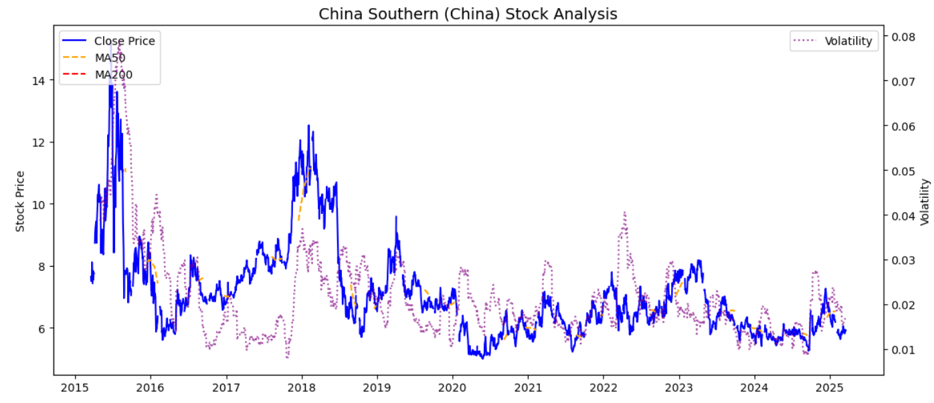
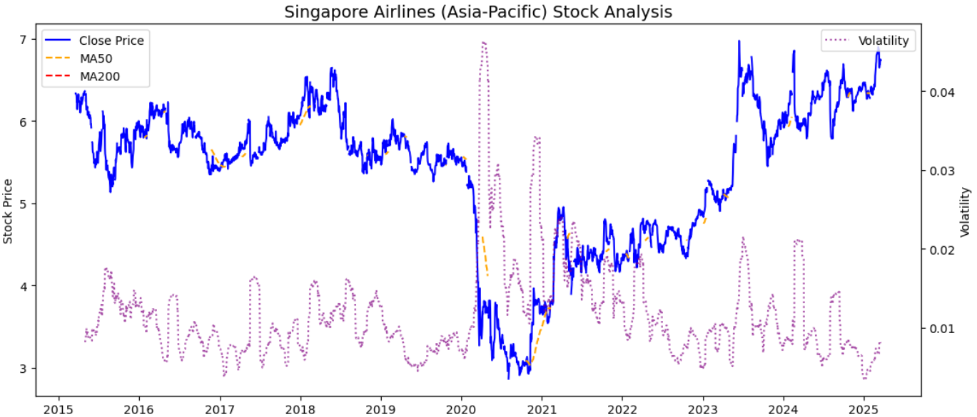
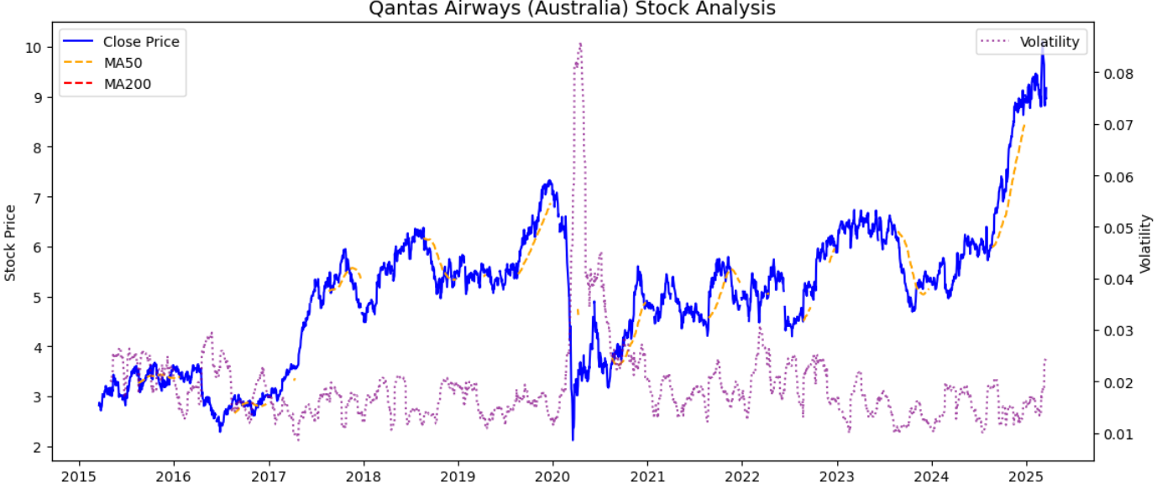


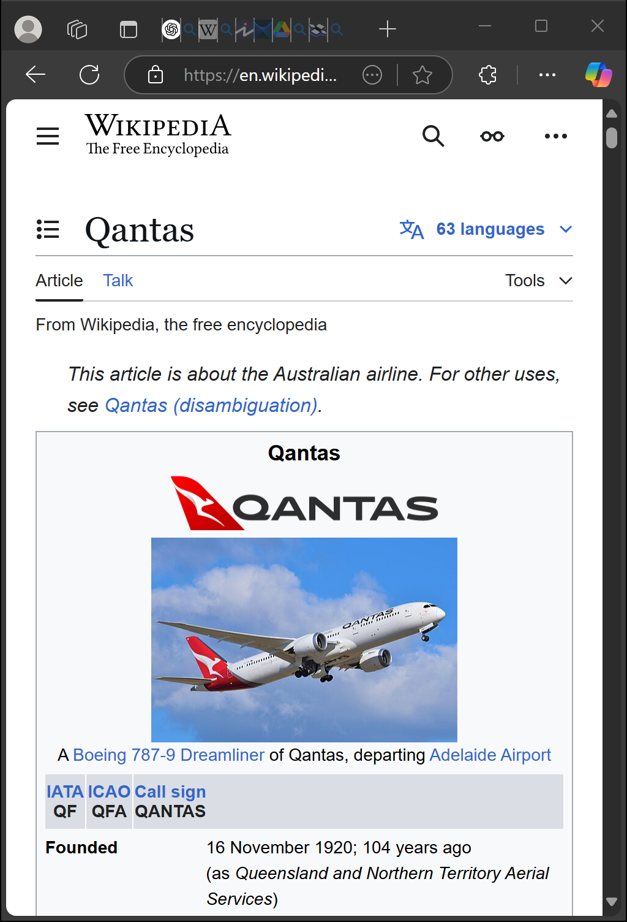
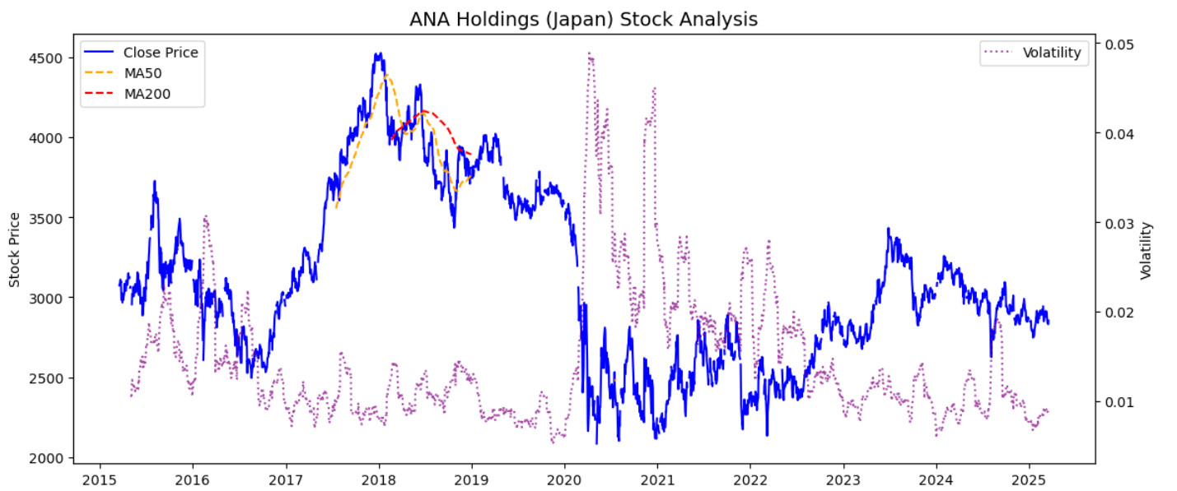
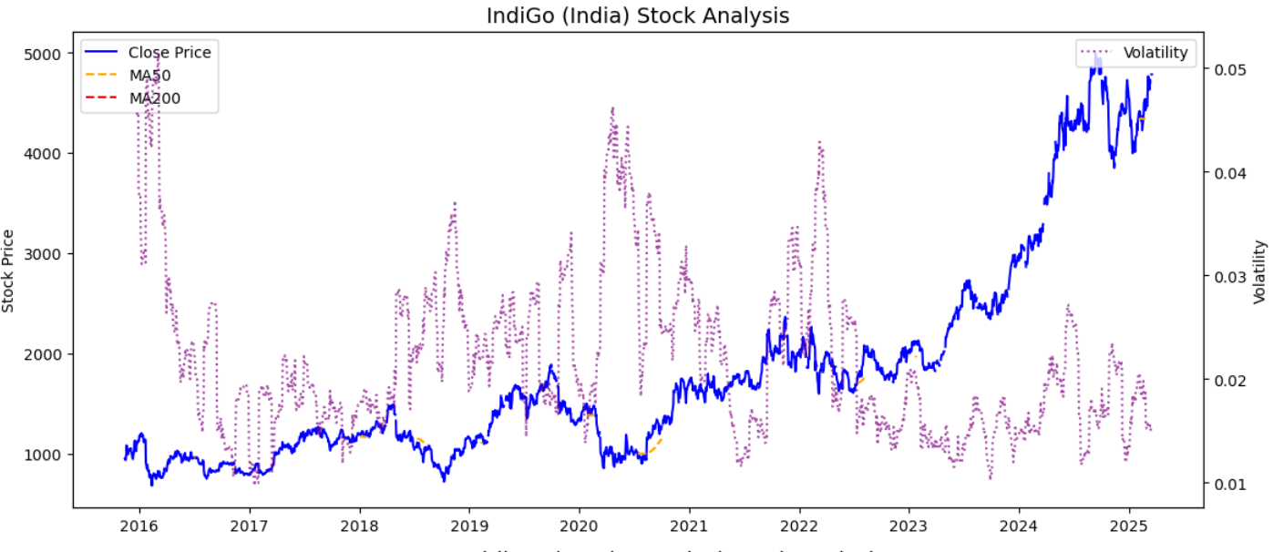
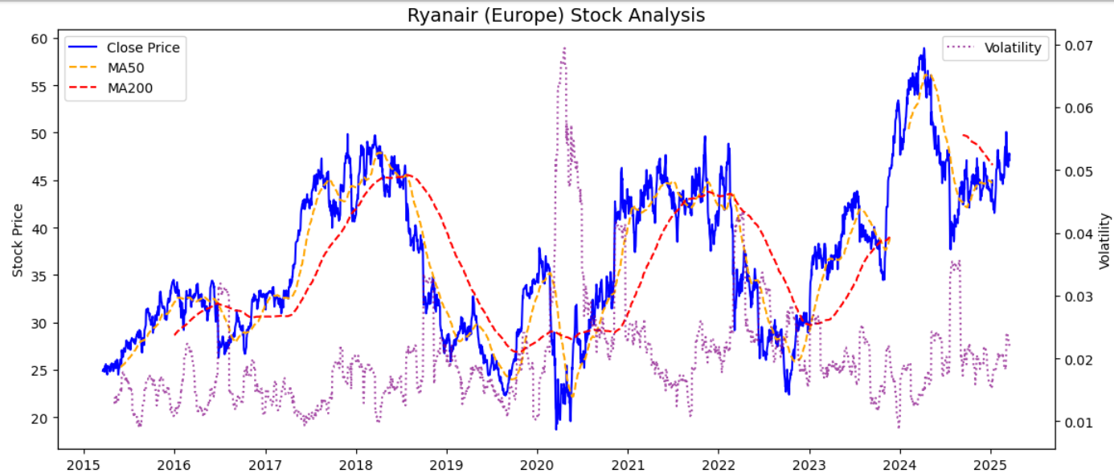



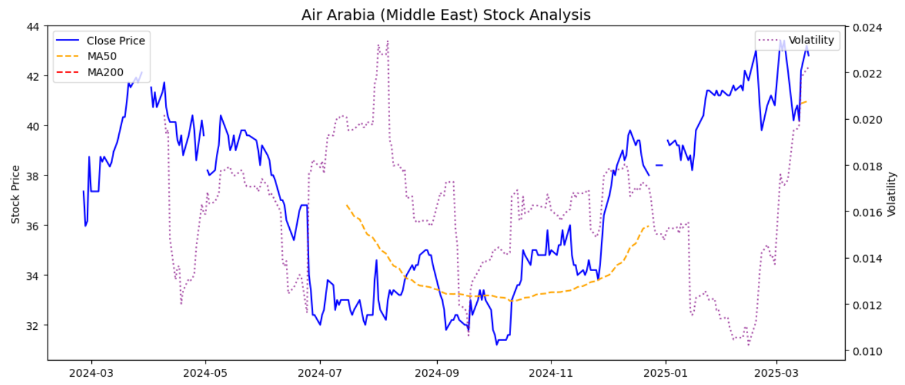
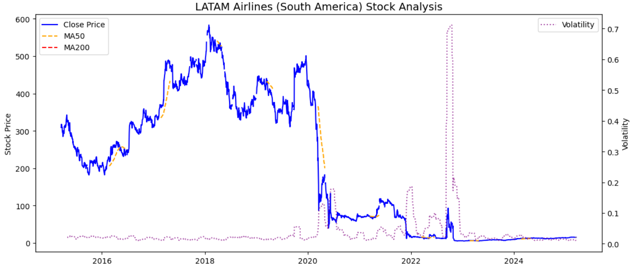
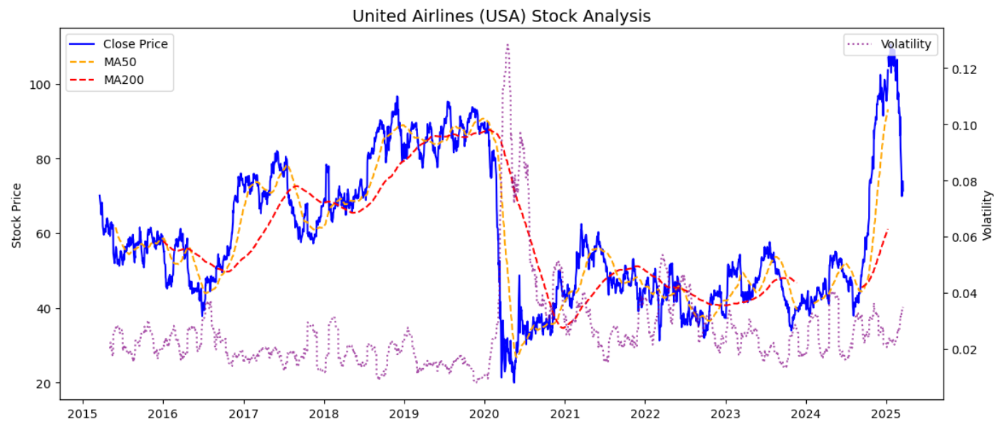
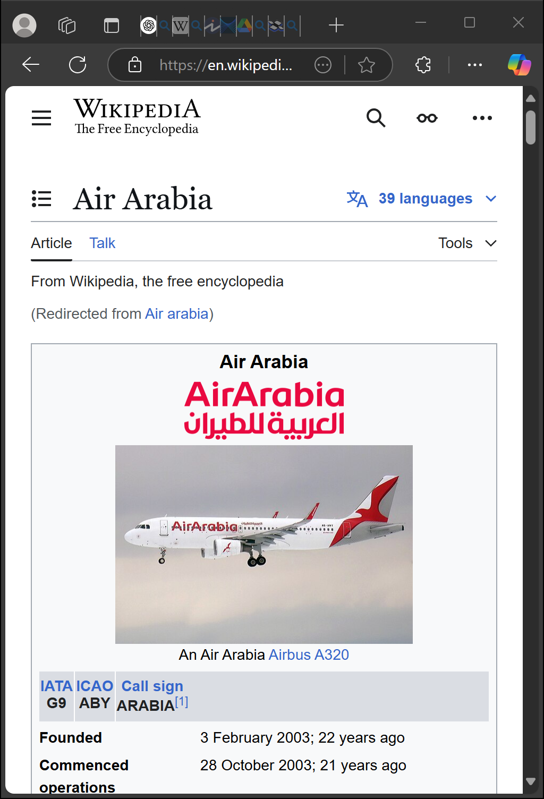
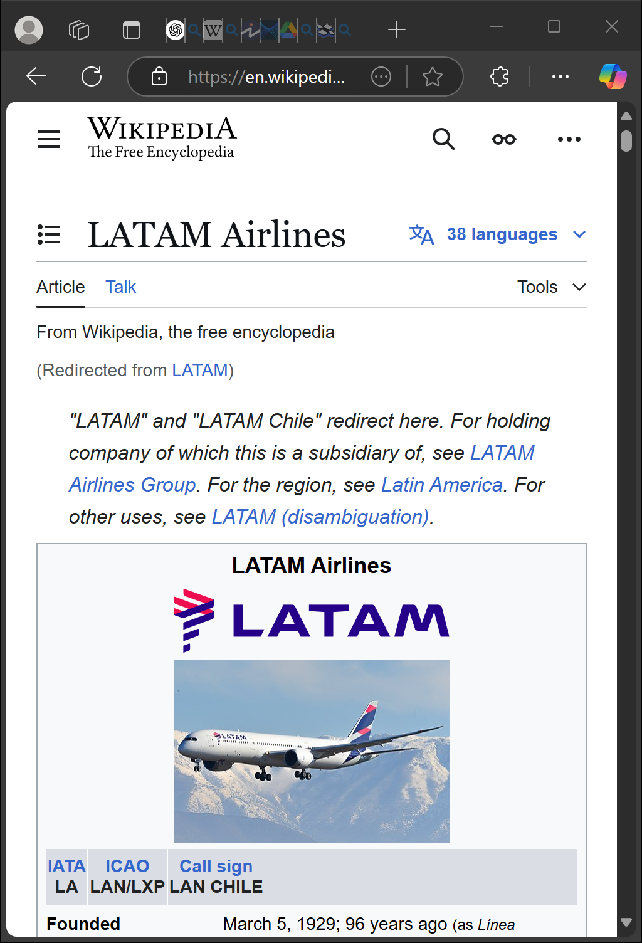


Slide 3
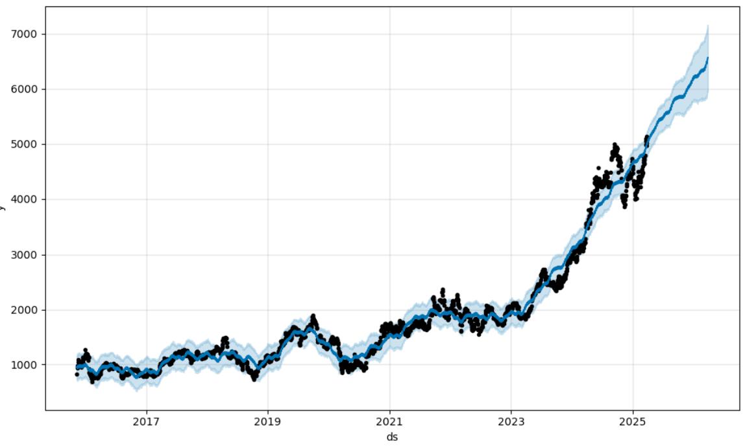
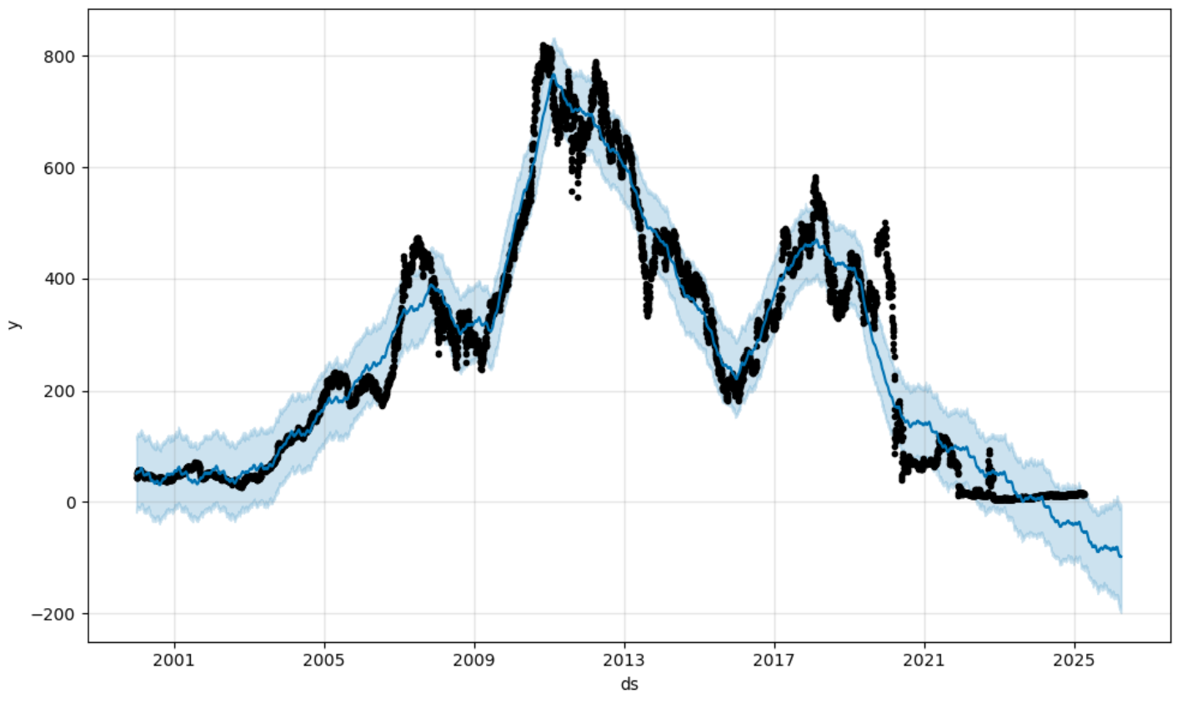
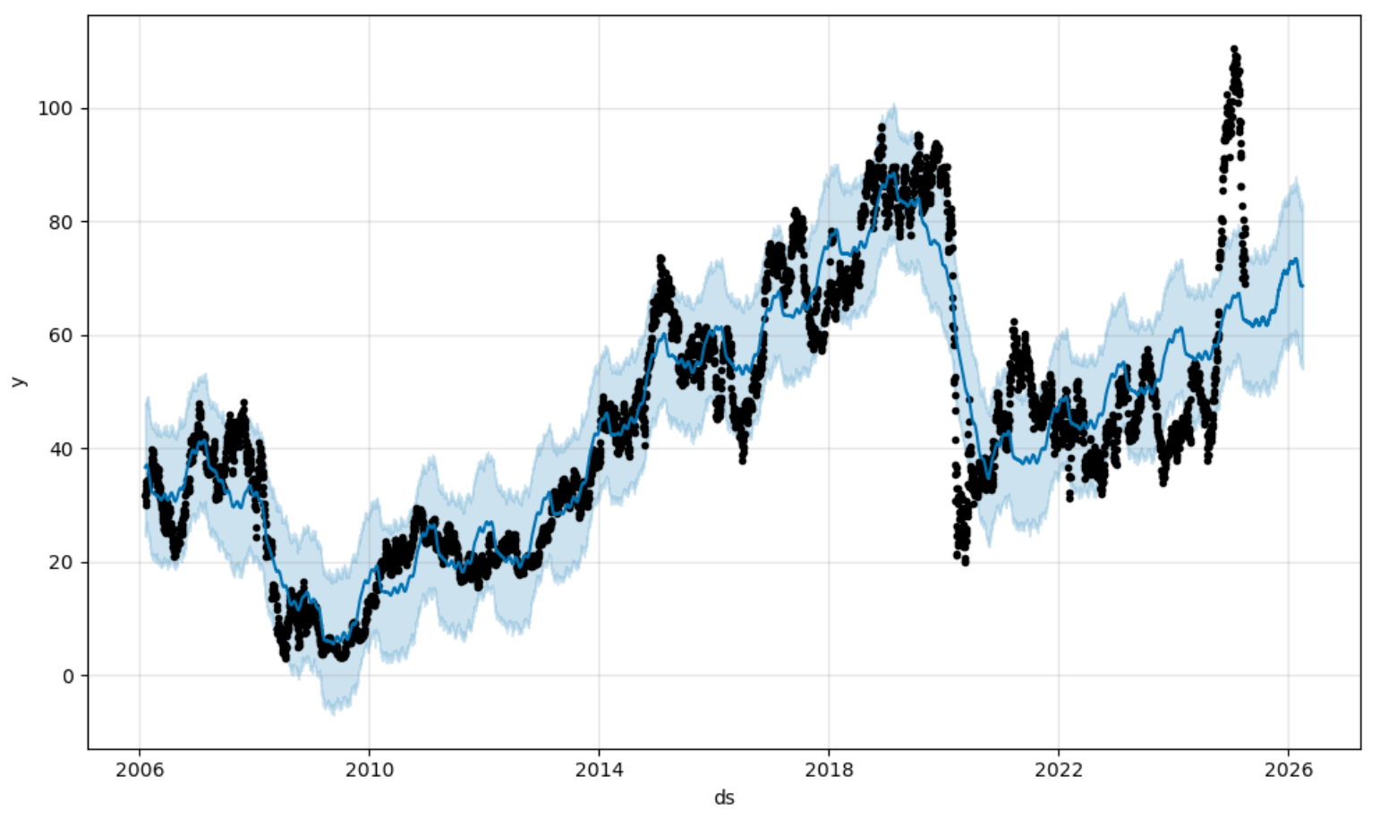

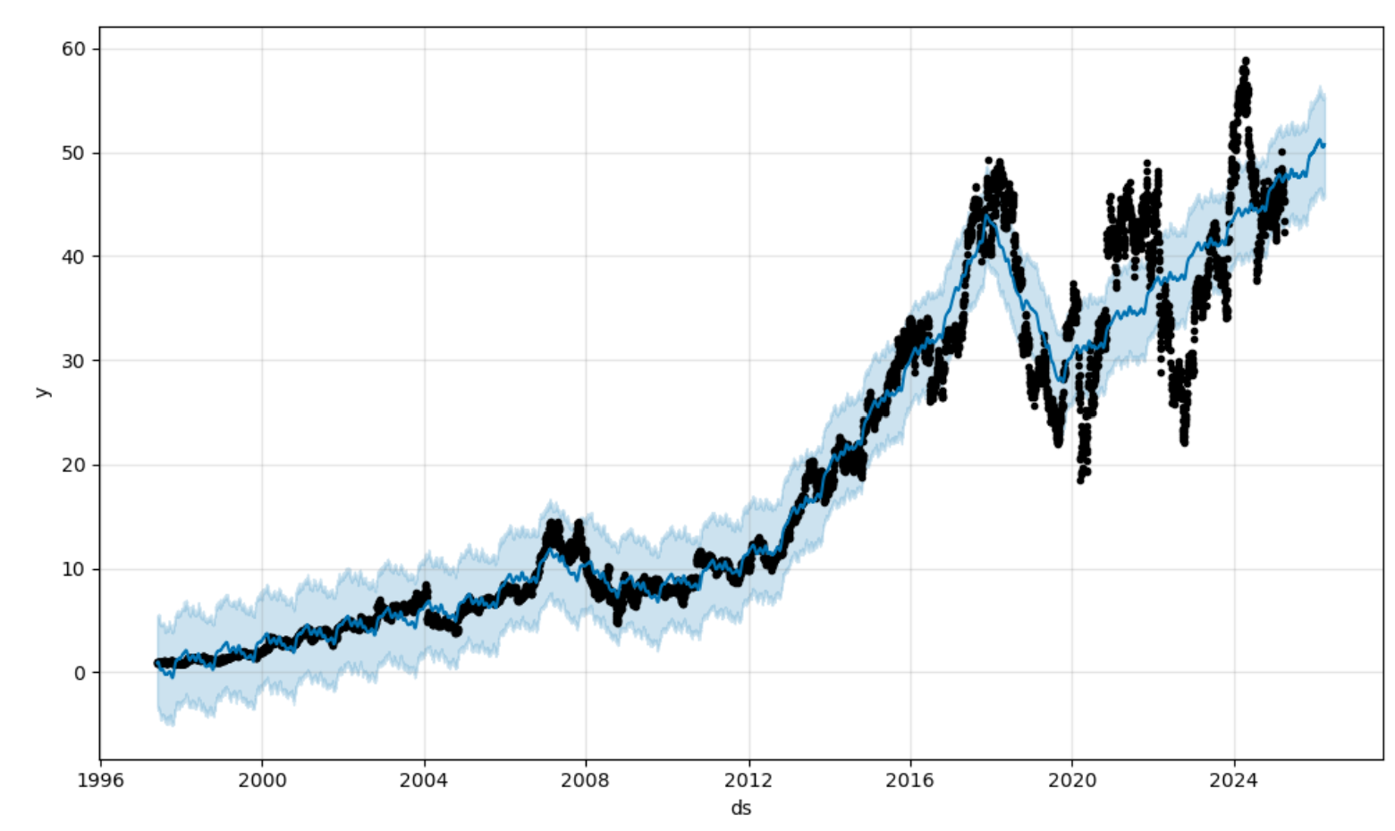
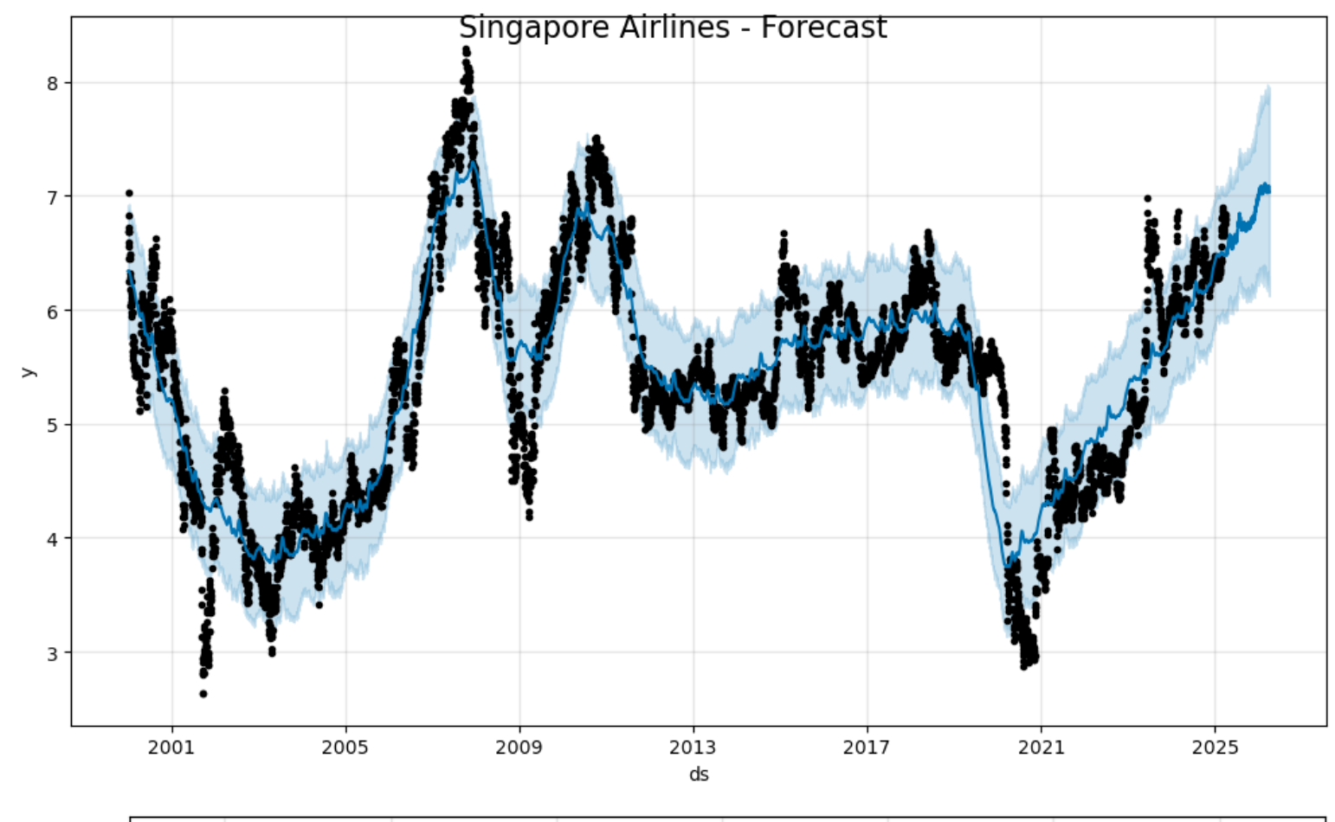
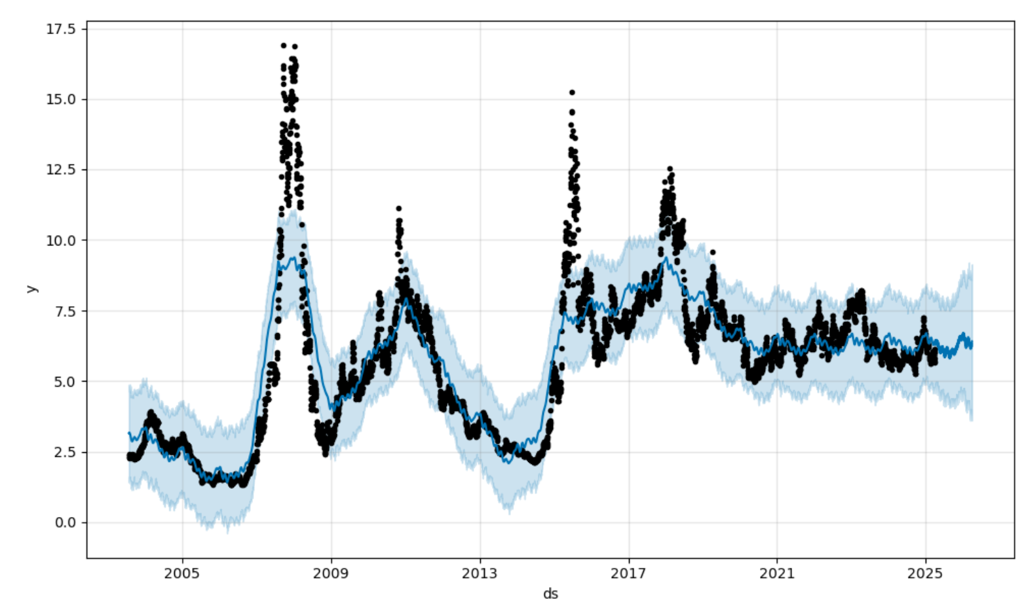
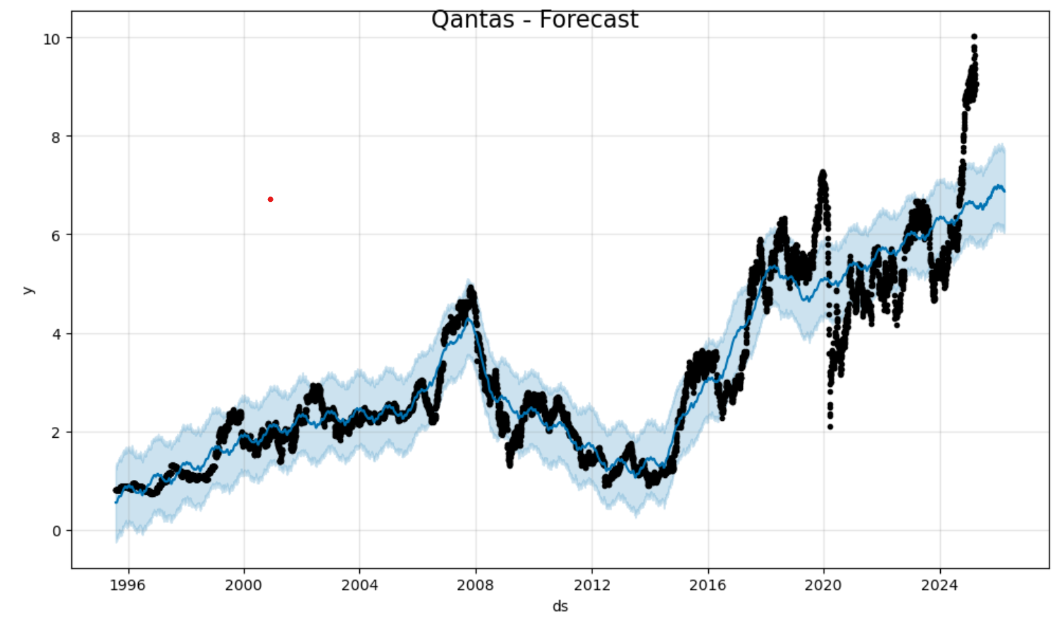
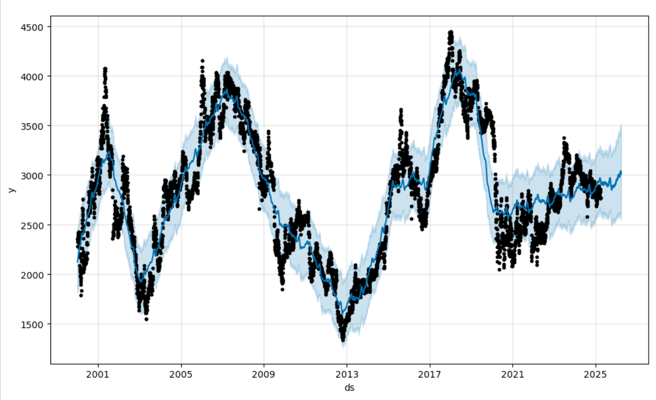
KEY INSIGHTS
Airlines like IndiGo, RyanAir, United , Qantas and Singapore Airlines show upward momentum- aligning with national and institutional priorities
ANA and China Southern appear stagnant in forecast- reflecting a plateau in regional aviation recovery or shifts in capital allocation to other strategic industries
In contrast, LatAm- which went through bankruptcy proceedings during the Pandemic, show a continued downward trend, aligning with financial vulnerabilities and possibly weaker systemic backing compared to other major carriers

Slide 4
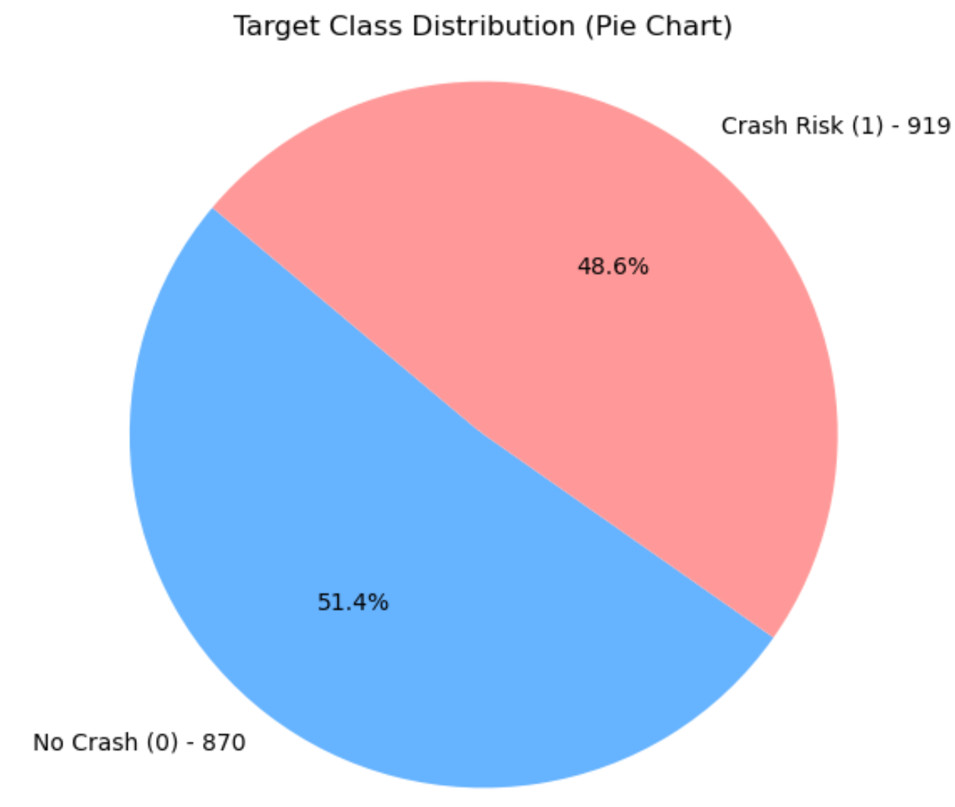
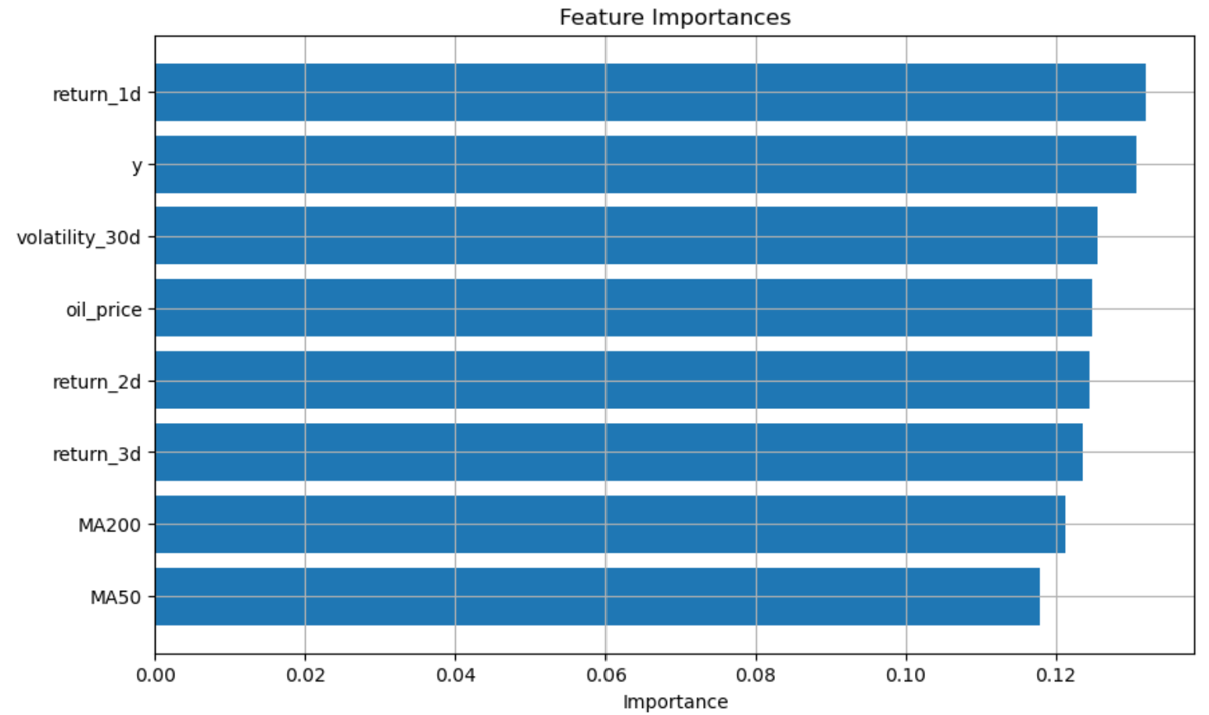
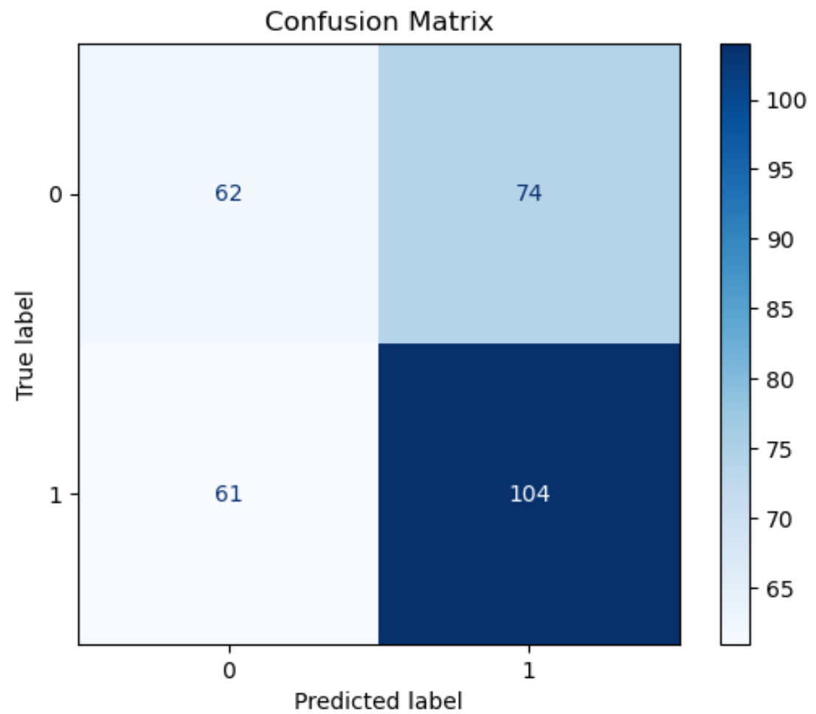
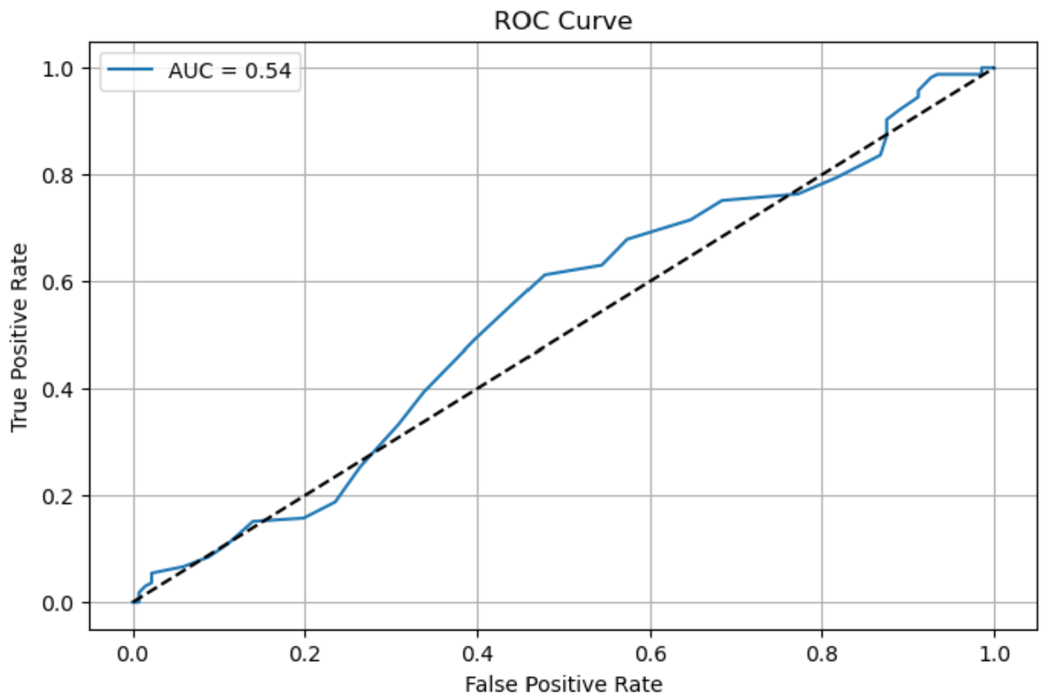
A predictive model used to analyse the risk of IndiGo’s stock price crash
KEY INSIGHTS:
There was an equal weightage between data which was classified as “crash risk” and “no crash”, implying no class bias
Accuracy was 0.55, meaning just better than chance.
AUC (Area under curve)- measuring predictive power of the model was 0.54, meaning only slightly better than random guessing
The confusion matrix revealed that the model is more reliable in detecting optimism or recovery signals in stock rather than early warnings of decline
Key feature importances indicated that short-term price movements (return_1d, return_2d, return_3d) and oil prices had some correlation but non were predictive
Accuracy:
55%

